Slide 1
Chapter 7
DC Biasing Circuits
Pictures are redrawn (with some modifications) from Introductory Electronic Devices and Circuits
By
Robert T. Paynter

Slide 2
Objectives
State the purpose of dc biasing circuits.
Plot the dc load line given the value of V_{CC} and the total collector-emitter circuit resistance.
Describe the Q-point of an amplifier.
Describe and analyze the operations of various bias circuits:
  base-bias circuits
  voltage-divider bias circuits
  emitter-bias circuits
  collector-feedback bias circuits
  emitter-feedback bias circuits

Slide 3
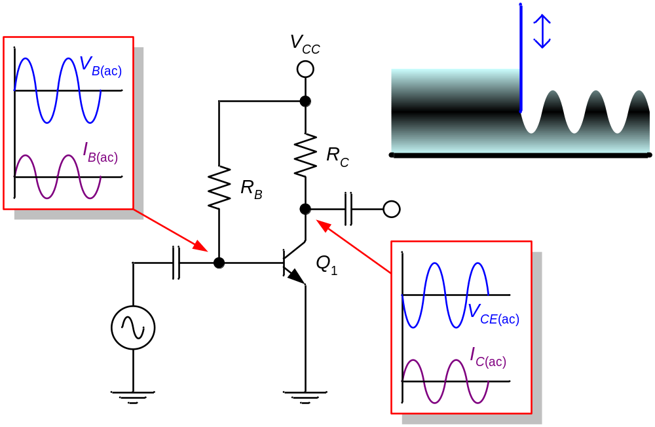
Fig 7.1 Typical amplifier operation.

Slide 4
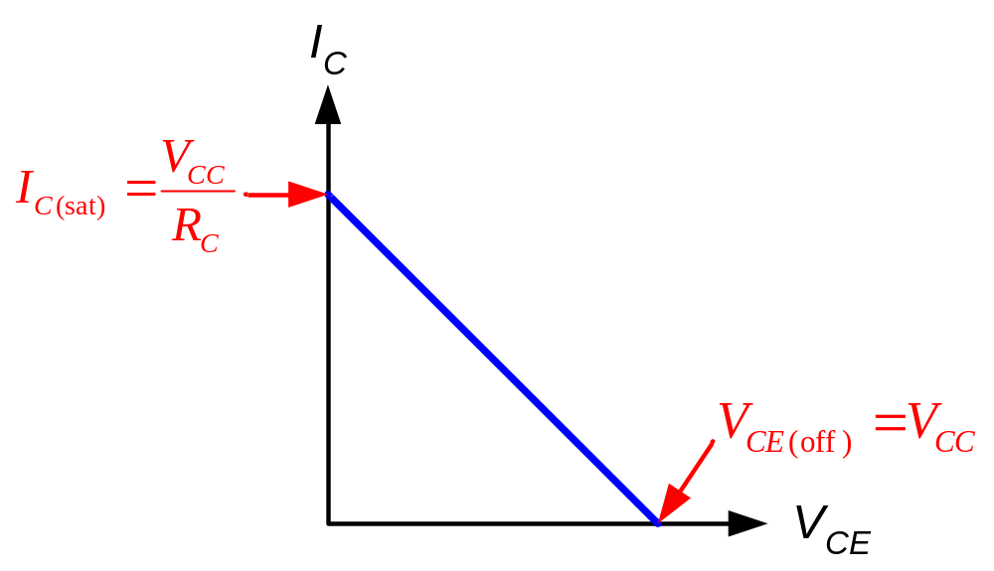
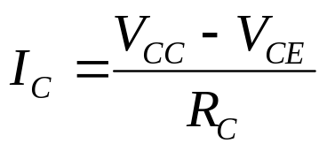
Fig 7.2 A generic dc load line.

Slide 5
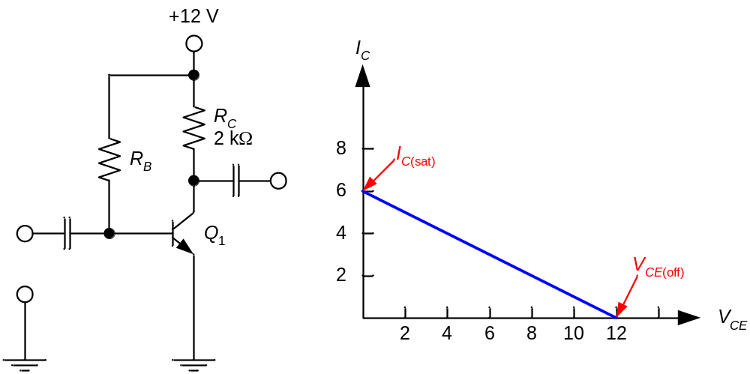
Fig 7.3 Example 7.1.
Plot the dc load line for the circuit shown in Fig. 7.3a.

Slide 6
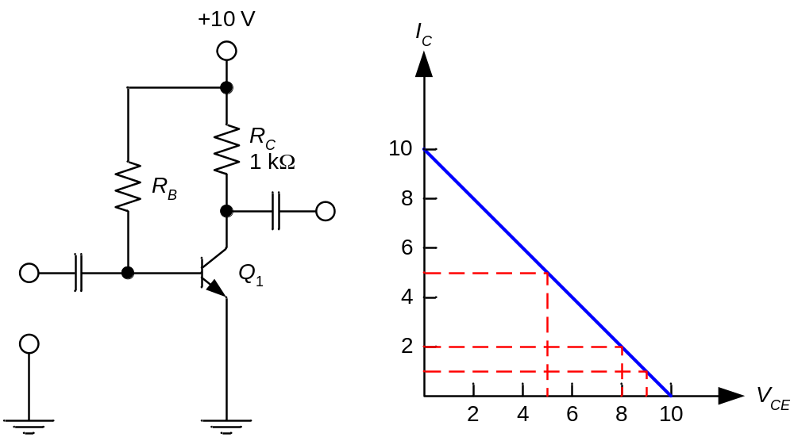
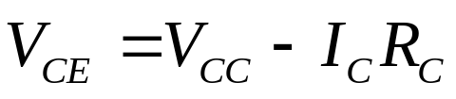
Fig 7.4 Example 7.2.
Plot the dc load line for the circuit shown in Fig. 7.4. Then, find the values of V_{CE} for I_{C} = 1, 2, 5 mA respectively.
I_{C} (mA) | V_{CE} (V)
1 | 9
2 | 8
5 | 5

Slide 7
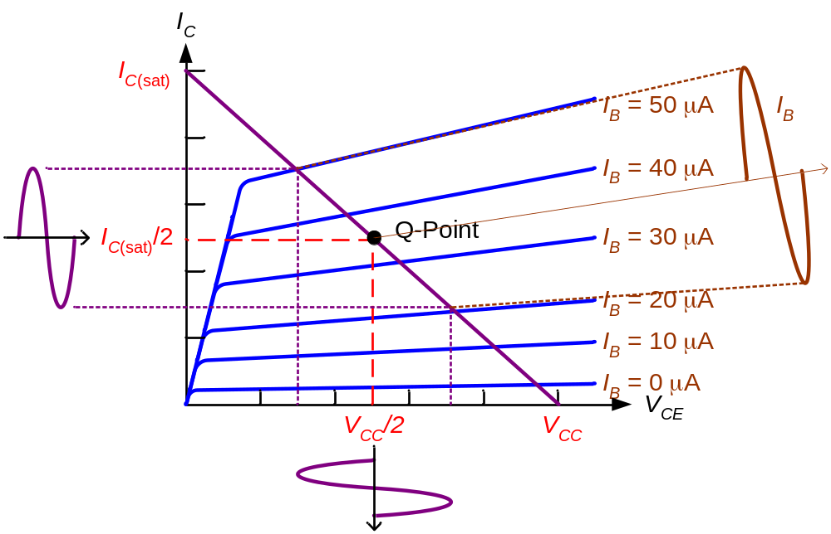
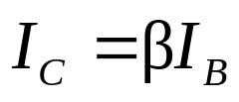

Fig 7.6-8 Optimum Q-point with amplifier operation.

Slide 8
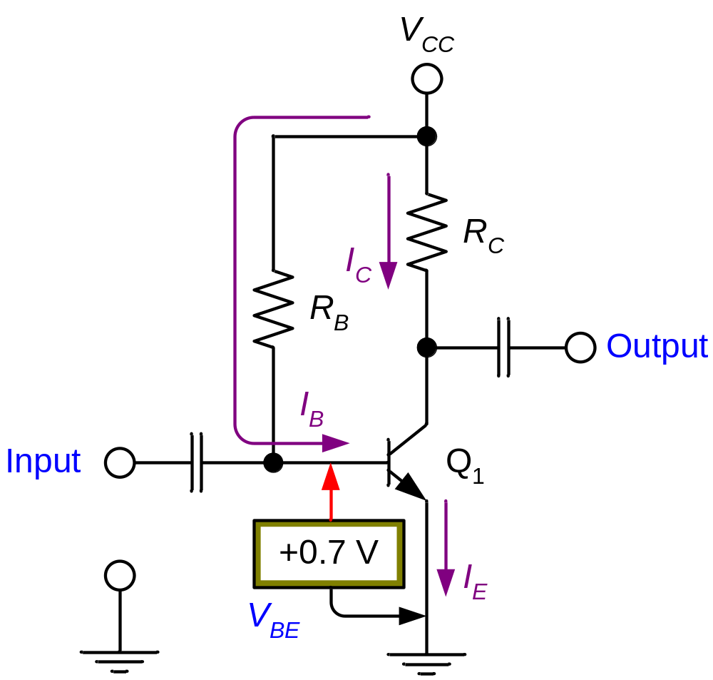
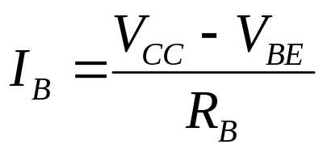

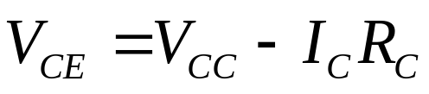
Fig 7.9 Base bias (fixed bias).
β = dc current gain = h_{FE}

Slide 9
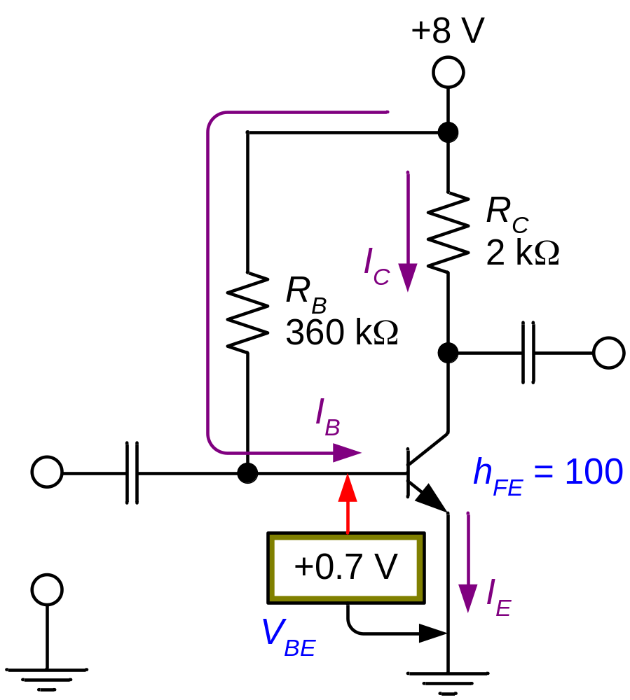
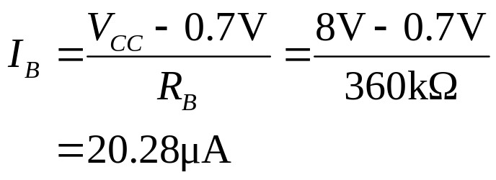
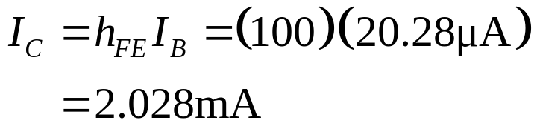
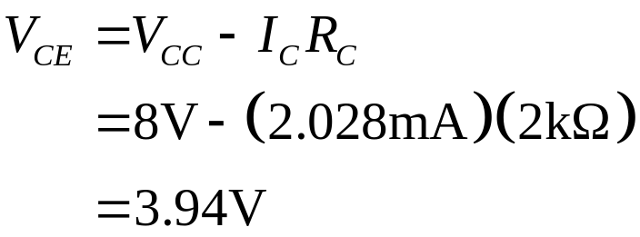
Fig 7.10 Example 7.3.
The circuit is midpoint biased.

Slide 10
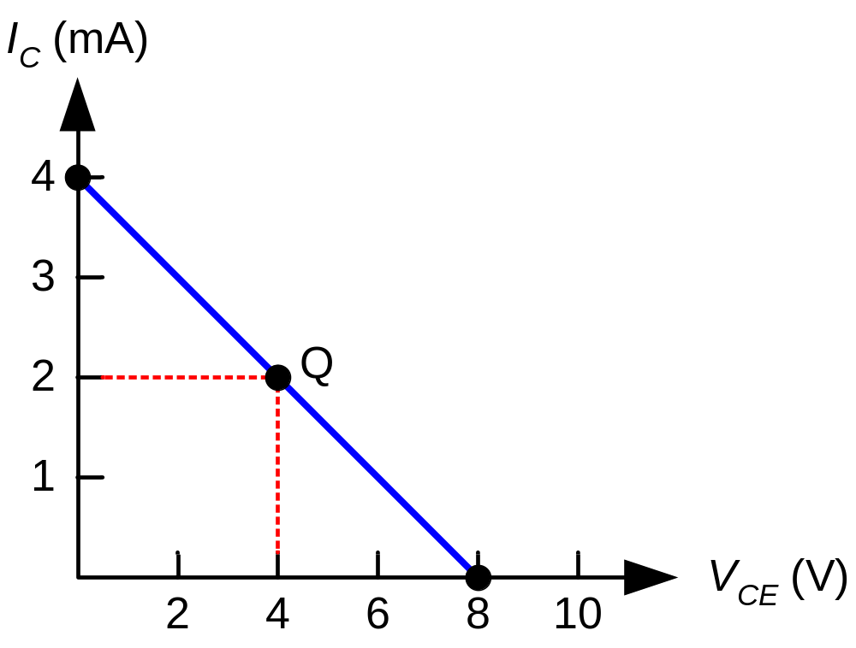
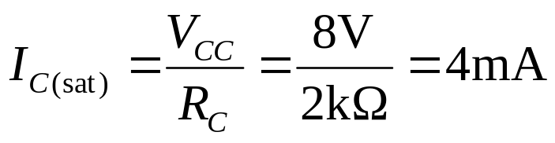
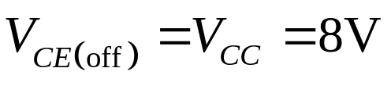
Fig 7.11 Example 7.4.
Construct the dc load line for the circuit shown in Fig. 7.10, and plot the Q-point from the values obtained in Example 7.3. Determine whether the circuit is midpoint biased.

Slide 11
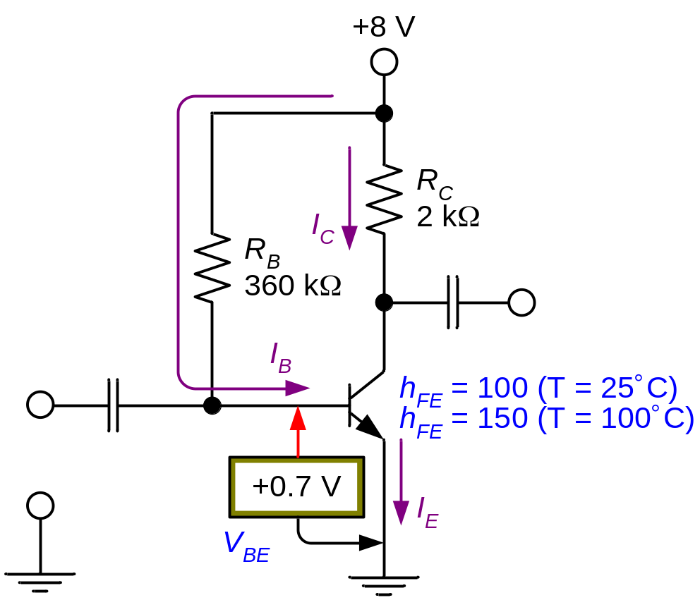
Fig 7.12 Example 7.6. (Q-point shift.)
The transistor in Fig. 7.12 has values of h_{FE} = 100 when T = 25 °C and h_{FE} = 150 when T = 100 °C. Determine the Q-point values of I_{C} and V_{CE} at both of these temperatures.
Temp(°C) | I_{B} (μA) | I_{C} (mA) | V_{CE} (V)
25 | 20.28 | 2.028 | 3.94
100 | 20.28 | 3.04 | 1.92

Slide 12

Fig 7.13 Base bias characteristics. (1)
Circuit recognition: A single resistor (R_{B}) between the base terminal and V_{CC}. No emitter resistor.
Advantage: Circuit simplicity.
Disadvantage: Q-point shift with temp.
Applications: Switching circuits only.

Slide 13
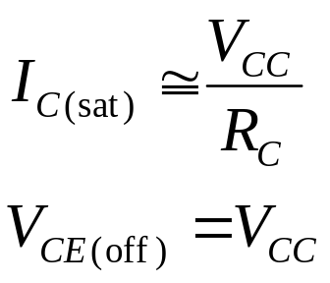
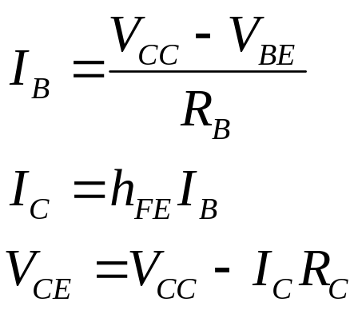
Fig 7.13 Base bias characteristics. (2)
Load line equations:
Q-point equations:

Slide 14
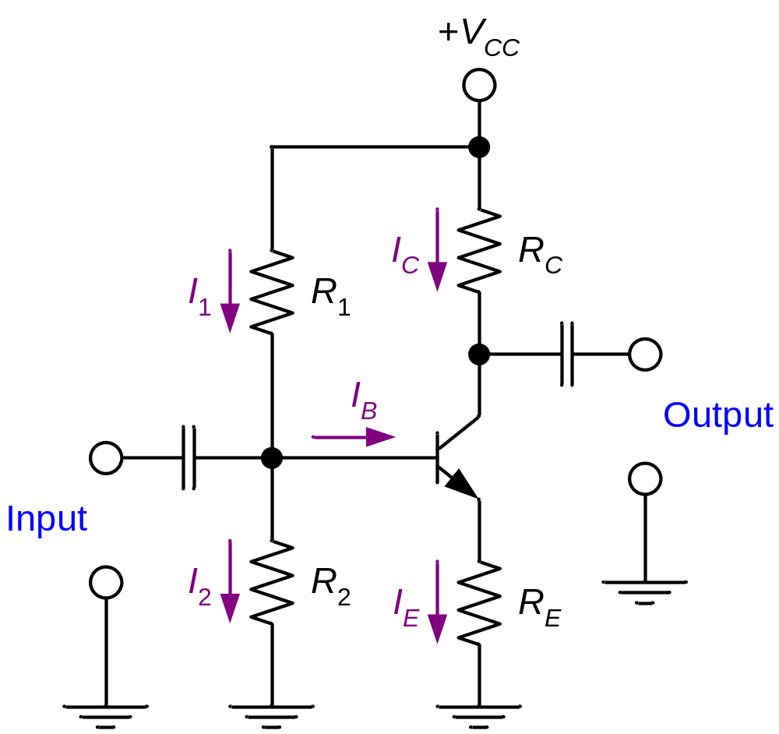
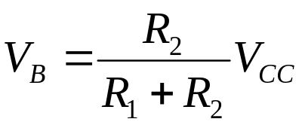

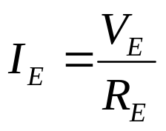
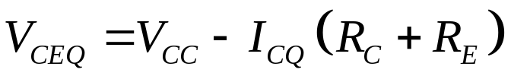
Fig 7.14 Voltage divider bias. (1)
Assume that I₂ > 10I_{B}.
Assume that I_{CQ} ≅ I_{E} (or h_{FE} >> 1). Then

Slide 15
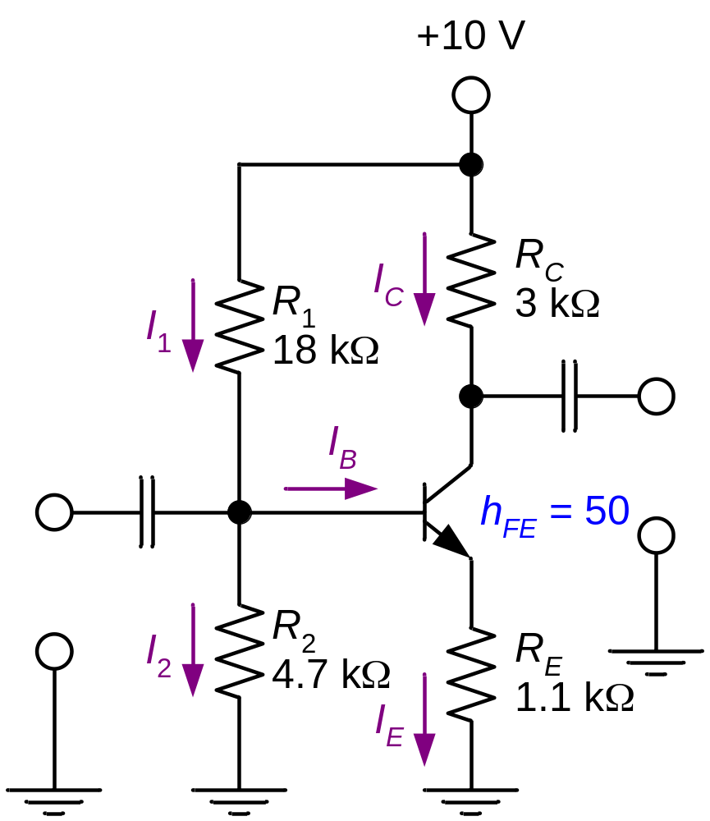
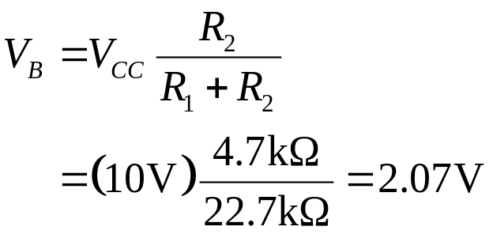
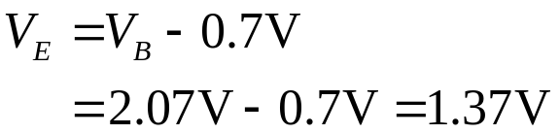
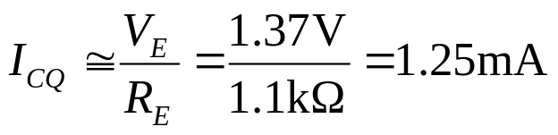
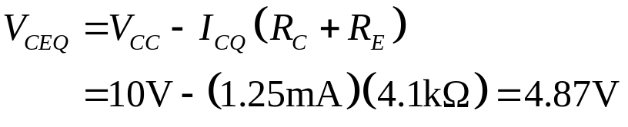
Fig 7.15 Example 7.7. (1)
Determine the values of I_{CQ} and V_{CEQ} for the circuit shown in Fig. 7.15.
Because I_{CQ} ≅ I_{E} (or h_{FE} >> 1),

Slide 16
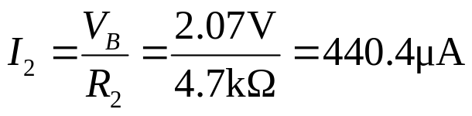
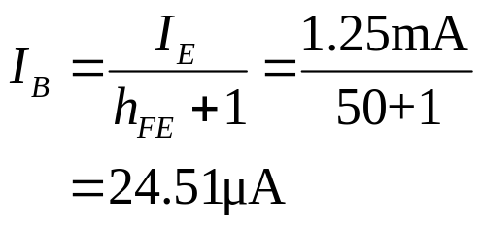

Fig 7.15 Example 7.7. (2)
Verify that I₂ > 10 I_{B}.

Slide 17
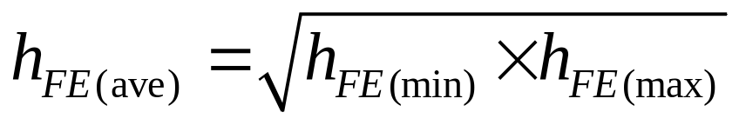
Which value of h_{FE} do I use?
Transistor specification sheet may list any combination of the following h_{FE}: max. h_{FE}, min. h_{FE}, or typ. h_{FE}. Use typical value if there is one. Otherwise, use

Slide 18
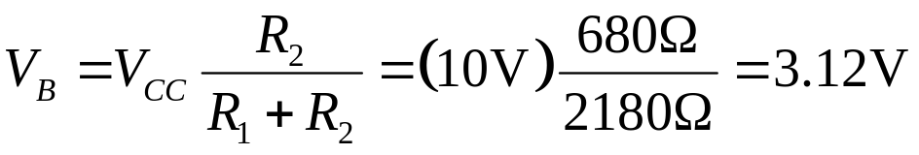
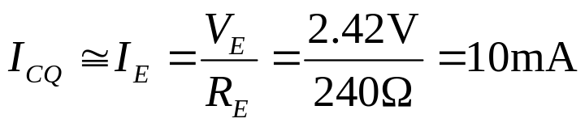
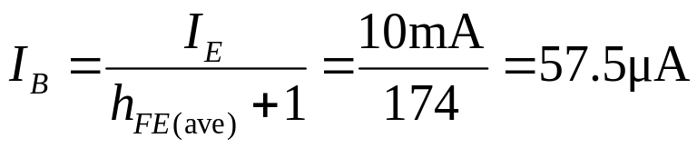
Example 7.9
A voltage-divider bias circuit has the following values: R₁ = 1.5 kΩ, R₂ = 680 Ω, R_{C} = 260 Ω, R_{E} = 240 Ω and V_{CC} = 10 V. Assuming the transistor is a 2N3904, determine the value of I_{B} for the circuit.

Slide 19
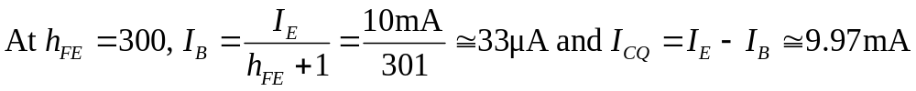
Stability of Voltage Divider
Bias Circuit
The Q-point of voltage divider bias circuit is less dependent on h_{FE} than that of the base bias (fixed bias).
For example, if I_{E} is exactly 10 mA, the range of h_{FE} is 100 to 300. Then
I_{CQ} hardly changes over the entire range of h_{FE}.

Slide 20
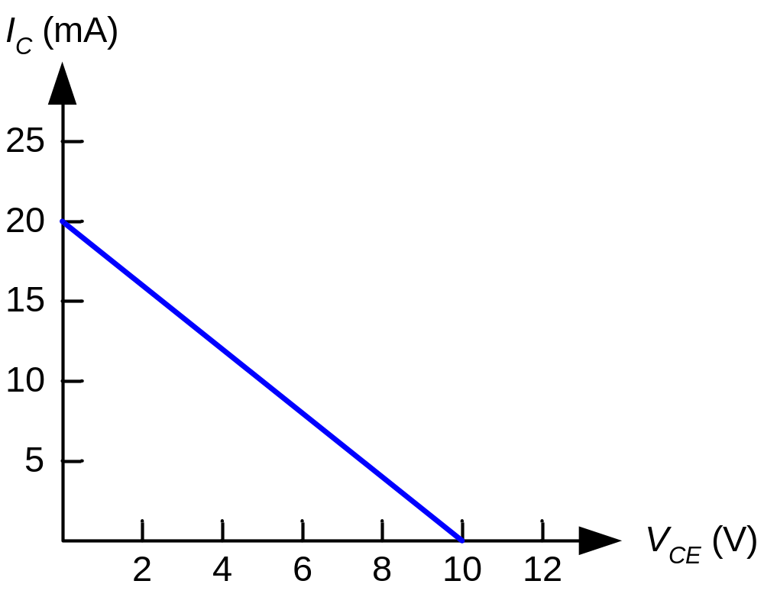
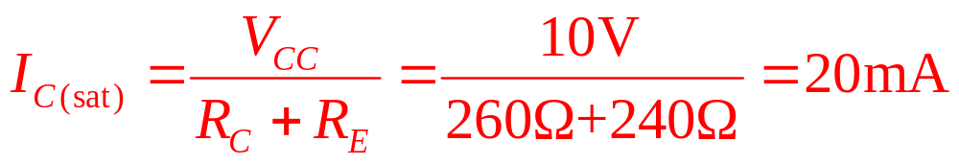

Fig 7.18 Load line for voltage divider bias circuit.
Circuit values are from Example 7.9.

Slide 21
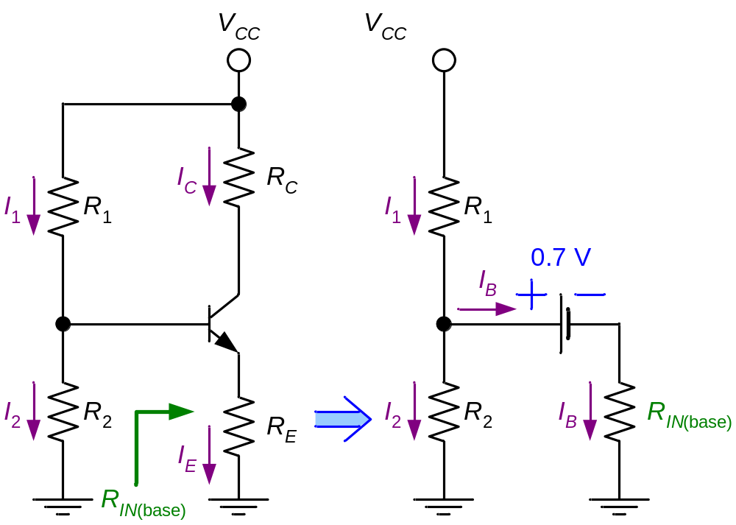
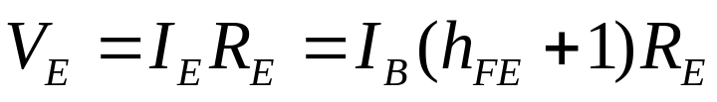
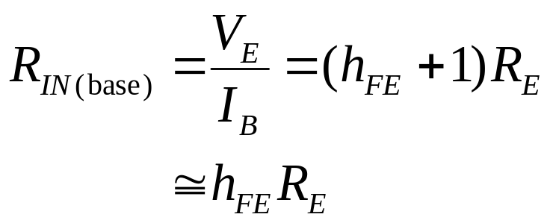
Fig 7.19-20 Base input resistance. (1)
May be ignored.

Slide 22
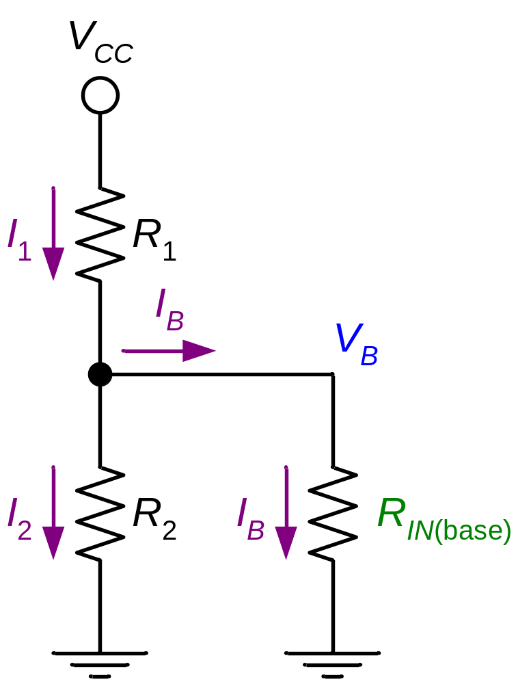
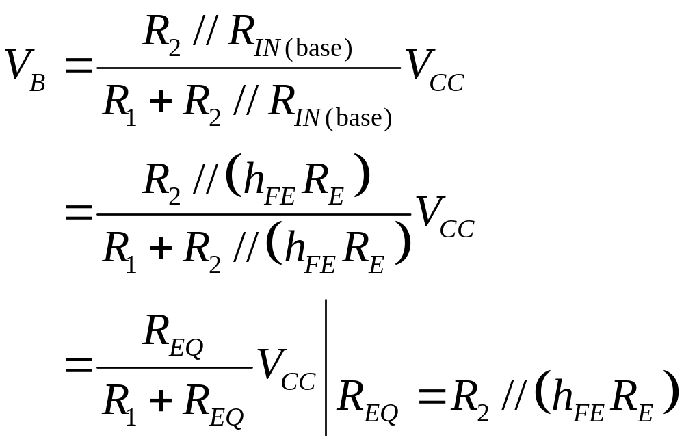
Fig 7.19-20 Base input resistance. (2)

Slide 23
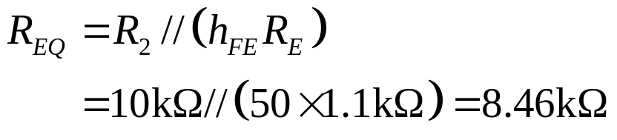
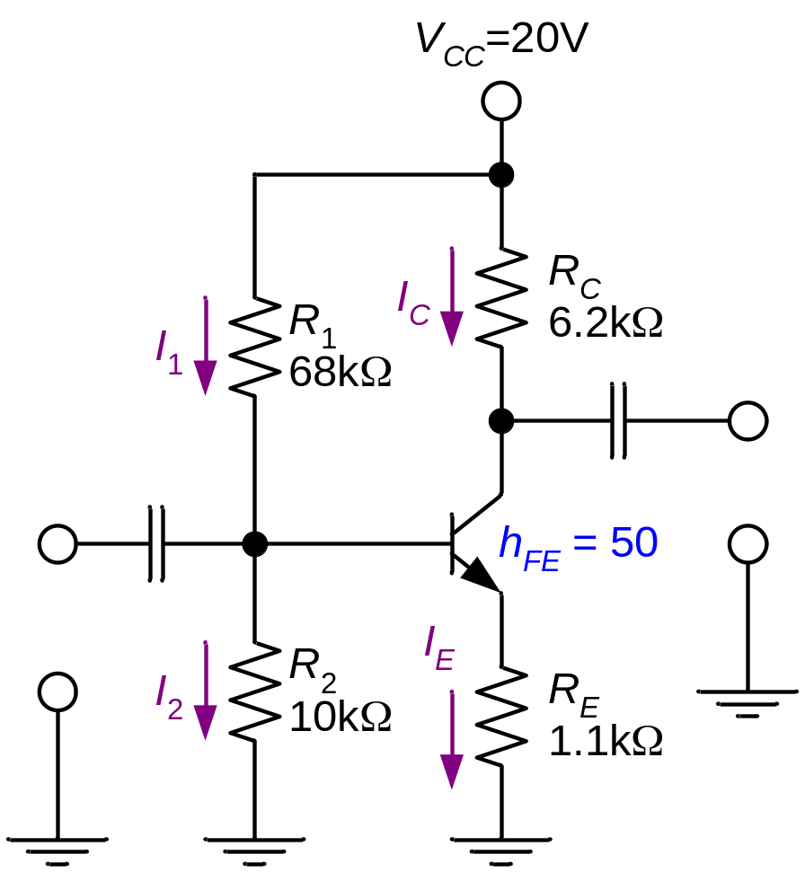
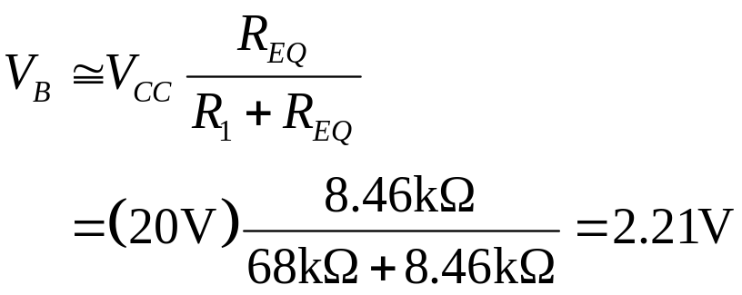
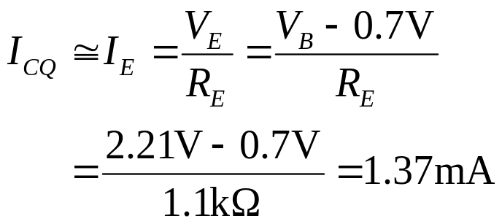
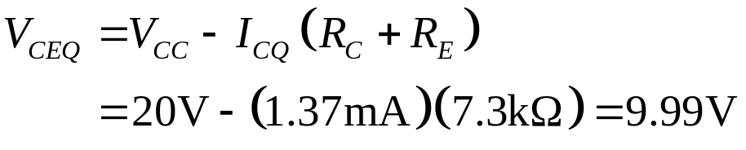
Fig 7.21 Example 7.11.

Slide 24
Fig 7.24 Voltage-divider bias characteristics. (1)
Circuit recognition: The voltage divider in the base circuit.
Advantages: The circuit Q-point values are stable against changes in h_{FE}.
Disadvantages: Requires more components than most other biasing circuits.
Applications: Used primarily to bias linear amplifier.

Slide 25
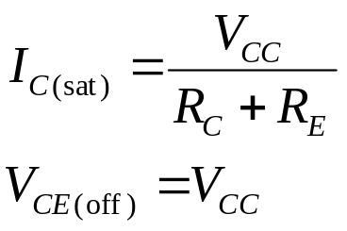

Fig 7.24 Voltage-divider bias characteristics. (2)
Load line equations:
Q-point equations (assume that h_{FE}R_{E} > 10R₂):

Slide 26
Other Transistor Biasing Circuits
Emitter-bias circuits
Feedback-bias circuits
  Collector-feedback bias
  Emitter-feedback bias

Slide 27






Fig 7.25-6 Emitter bias.
Assume that the transistor operation is in active region.
Assume that h_{FE} >> 1.

Slide 28




Fig 7.27 Example 7.12.
Determine the values of I_{CQ} and V_{CEQ} for the amplifier shown in Fig.7.27.

Slide 29



Load Line for
Emitter-Bias Circuit

Slide 30
Fig 7.28 Emitter-bias characteristics. (1)
Circuit recognition: A split (dual-polairty) power supply and the base resistor is connected to ground.
Advantage: The circuit Q-point values are stable against changes in h_{FE}.
Disadvantage: Requires the use of dual-polarity power supply.
Applications: Used primarily to bias linear amplifiers.

Slide 31


Fig 7.28 Emitter-bias characteristics. (2)
Load line equations:
Q-point equations:

Slide 32





Fig 7.29 Collector-feedback bias.

Slide 33




Fig 7.30 Example 7.14.
Determine the values of I_{CQ} and V_{CEQ} for the amplifier shown in Fig. 7.30.

Slide 34

Circuit Stability of
Collector-Feedback Bias
h_{FE} increases
I_{C} increases (if I_{B} is the same)
V_{CE} decreases
I_{B} decreases
I_{C} does not increase that much.
Good Stability. Less dependent on h_{FE} and temperature.

Slide 35
Collector-Feedback
Characteristics (1)
Circuit recognition: The base resistor is connected between the base and the collector terminals of the transistor.
Advantage: A simple circuit with relatively stable Q-point.
Disadvantage: Relatively poor ac characteristics.
Applications: Used primarily to bias linear amplifiers.

Slide 36

Collector-Feedback
Characteristics (2)
Q-point relationships:

Slide 37





Fig 7.31 Emitter-feedback bias.

Slide 38




Fig 7.32 Example 7.15.

Slide 39
Circuit Stability of
Emitter-Feedback Bias
h_{FE} increases
I_{C} increases (if I_{B} is the same)
V_{E} increases
I_{B} decreases
I_{C} does not increase that much.
I_{C} is less dependent on h_{FE} and temperature.

Slide 40
Emitter-Feedback
Characteristics (1)
Circuit recognition: Similar to voltage divider bias with R₂ missing (or base bias with R_{E} added).
Advantage: A simple circuit with relatively stable Q-point.
Disadvantage: Requires more components than collector-feedback bias.
Applications: Used primarily to bias linear amplifiers.

Slide 41


Emitter-Feedback
Characteristics (2)
Q-point relationships:

Slide 42
Summary
DC Biasing and the dc load line
Base bias circuits
Voltage-divider bias circuits
Emitter-bias circuits
Feedback-bias circuits
  Collector-feedback bias circuits
  Emitter-feedback bias circuits

